Slide 1
Design and Analysis of Algorithm Greedy Methods (Activity Selection Algorithm, Task Scheduling, Huffman Coding )
Lecture – 45 - 50

Slide 2
Overview
A greedy algorithm always makes the choice that looks best at the moment. (i.e. it makes a locally optimal choice in the hope that this choice will lead to a globally optimal solution).
The objective of this section is to explores optimization problems that are solvable by greedy algorithms.

Slide 3
Greedy Algorithm
In mathematics, computer science and economics, an optimization problem is the problem of finding the best solution from all feasible solutions.
Algorithms for optimization problems typically go through a sequence of steps, with a set of choices at each step.
Many optimization problems can be solved using a greedy approach.
Greedy algorithms are simple and straightforward.

Slide 4
Greedy Algorithm
A greedy algorithm always makes the choice that looks best at the moment.
That is, it makes a locally optimal choice in the hope that this choice will lead to a globally optimal solution.
Greedy algorithms do not always yield optimal solutions, but for many problems they do.
This algorithms are easy to invent, easy to implement and most of the time provides best and optimized solution.

Slide 5
Greedy Algorithm
Application of Greedy Algorithm:
A simple but nontrivial problem, the activity-selection problem, for which a greedy algorithm efficiently computes a solution.
In combinatorics,(a branch of mathematics), a ‘matroid’ is a structure that abstracts and generalizes the notion of linear independence in vector spaces. Greedy algorithm always produces an optimal solution for such problems. Scheduling unit-time tasks with deadlines and penalties is an example of such problem.

Slide 6
Greedy Algorithm
Application of Greedy Algorithm:
An important application of greedy techniques is the design of data-compression codes (i.e. Huffman code) .
The greedy method is quite powerful and works well for a wide range of problems. They are:
Minimum-spanning-tree algorithms
(Example: Prims and Kruskal algorithm)
Single Source Shortest Path.
(Example: Dijkstra's and Bellman ford algorithm)

Slide 7
Greedy Algorithm
Application of Greedy Algorithm:
A problem exhibits optimal substructure if an optimal solution to the problem contains within it optimal solutions to subproblems.
This property is a key ingredient of assessing the applicability of dynamic programming as well as greedy algorithms.
The subtleties between the above two techniques are illustrated with the help of two variants of a classical optimization problem known as knapsack problem. These variants are:
0-1 knapsack problem (Dynamic Programming)
Fractional knapsack problem (Greedy Algorithm)

Slide 8
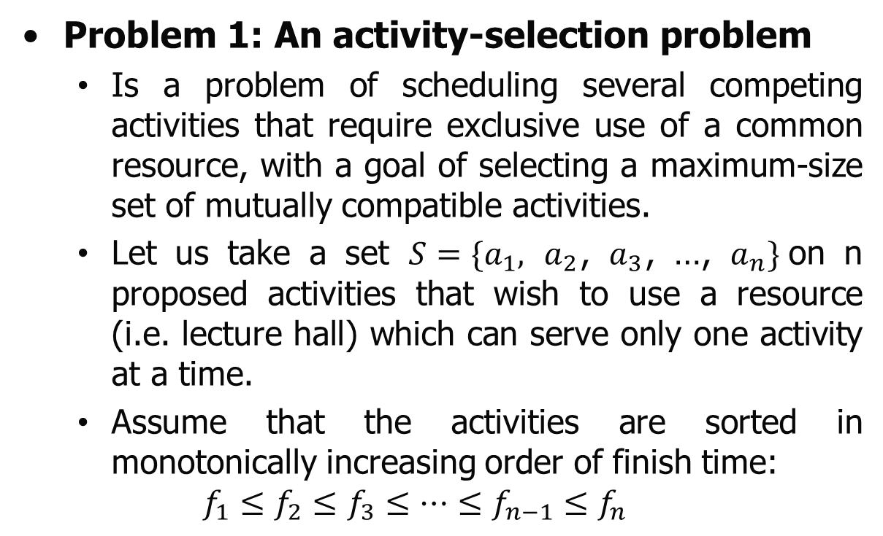
Greedy Algorithm
Problem 1: An activity-selection problem
Is a problem of scheduling several competing activities that require exclusive use of a common resource, with a goal of selecting a maximum-size set of mutually compatible activities.
Let us take a set $S=\{a_{1},$ $a_{2}$, $a_{3}$, …, $a_{n}\}$on n proposed activities that wish to use a resource (i.e. lecture hall) which can serve only one activity at a time.
Assume that the activities are sorted in monotonically increasing order of finish time:
$$f_{1}≤f_{2}≤f_{3}≤…≤f_{n−1}≤f_{n}$$

Slide 9
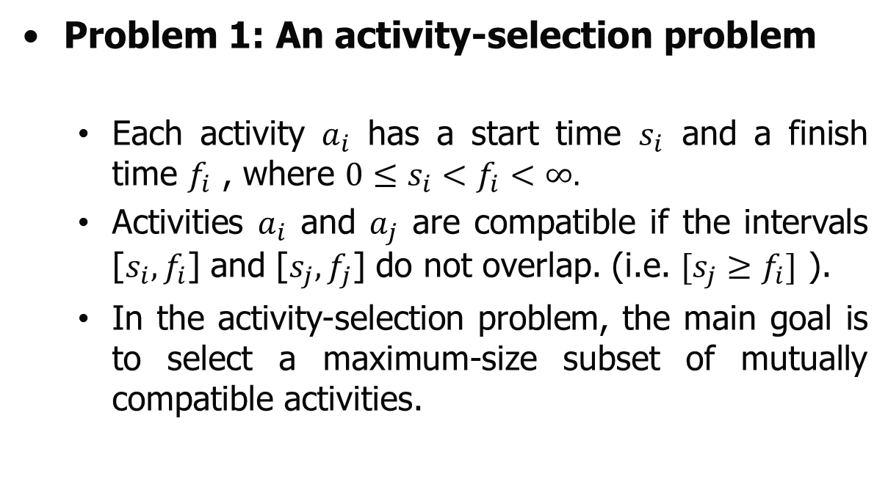
Greedy Algorithm
Problem 1: An activity-selection problem
Each activity $a_{i}$ has a start time $s_{i}$ and a finish time $f_{i}$ , where $0≤s_{i}<f_{i}<∞.$
Activities $a_{i}$ and $a_{j}$ are compatible if the intervals [$s_{i},f_{i}$] and [$s_{j},f_{j}$] do not overlap. (i.e. $[s_{j}≥f_{i}]$ ).
In the activity-selection problem, the main goal is to select a maximum-size subset of mutually compatible activities.

Slide 10
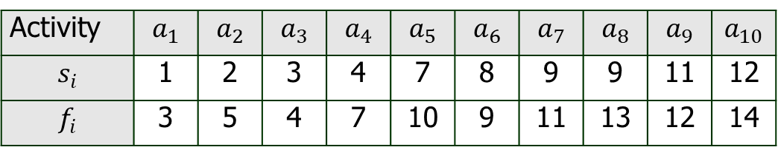
Greedy Algorithm
Problem 1: An activity-selection problem
Example 1: Given 10 activities with their start and finish time compute a schedule where the largest number of activities take place.
Activity | $$a_{1}$$ | $$a_{2}$$ | $$a_{3}$$ | $$a_{4}$$ | $$a_{5}$$ | $$a_{6}$$ | $$a_{7}$$ | $$a_{8}$$ | $$a_{9}$$ | $$a_{10}$$
$$s_{i}$$ | 1 | 2 | 3 | 4 | 7 | 8 | 9 | 9 | 11 | 12
$$f_{i}$$ | 3 | 5 | 4 | 7 | 10 | 9 | 11 | 13 | 12 | 14

Slide 11
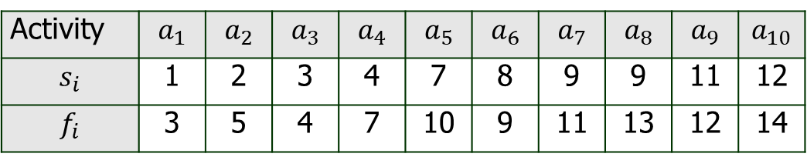
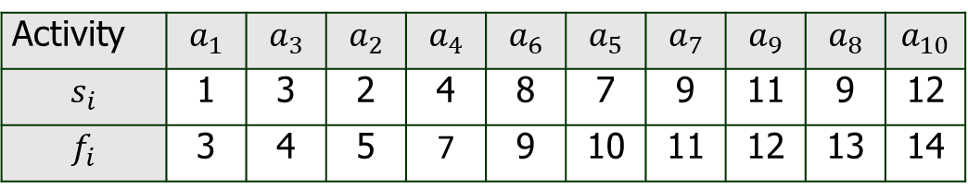
Greedy Algorithm
Problem 1: An activity-selection problem
Solution:
First arraigning the following activities in increasing order on their finishing
Activity | $$a_{1}$$ | $$a_{2}$$ | $$a_{3}$$ | $$a_{4}$$ | $$a_{5}$$ | $$a_{6}$$ | $$a_{7}$$ | $$a_{8}$$ | $$a_{9}$$ | $$a_{10}$$
$$s_{i}$$ | 1 | 2 | 3 | 4 | 7 | 8 | 9 | 9 | 11 | 12
$$f_{i}$$ | 3 | 5 | 4 | 7 | 10 | 9 | 11 | 13 | 12 | 14
Activity | $$a_{1}$$ | $$a_{3}$$ | $$a_{2}$$ | $$a_{4}$$ | $$a_{6}$$ | $$a_{5}$$ | $$a_{7}$$ | $$a_{9}$$ | $$a_{8}$$ | $$a_{10}$$
$$s_{i}$$ | 1 | 3 | 2 | 4 | 8 | 7 | 9 | 11 | 9 | 12
$$f_{i}$$ | 3 | 4 | 5 | 7 | 9 | 10 | 11 | 12 | 13 | 14

Slide 12
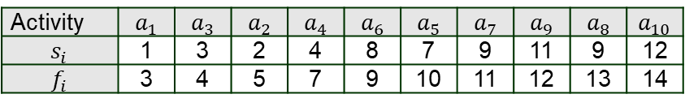

Greedy Algorithm
Problem 1: An activity-selection problem
Solution:
Activity | $$a_{1}$$ | $$a_{3}$$ | $$a_{2}$$ | $$a_{4}$$ | $$a_{6}$$ | $$a_{5}$$ | $$a_{7}$$ | $$a_{9}$$ | $$a_{8}$$ | $$a_{10}$$
$$s_{i}$$ | 1 | 3 | 2 | 4 | 8 | 7 | 9 | 11 | 9 | 12
$$f_{i}$$ | 3 | 4 | 5 | 7 | 9 | 10 | 11 | 12 | 13 | 14
$$a_{1}$$
0 | 1 | 2 | 3 | 4 | 5 | 6 | 7 | 8 | 9 | 10 | 11 | 12 | 13 | 14

Slide 13

Greedy Algorithm
Problem 1: An activity-selection problem
Solution:
Activity | $$a_{1}$$ | $$a_{3}$$ | $$a_{2}$$ | $$a_{4}$$ | $$a_{6}$$ | $$a_{5}$$ | $$a_{7}$$ | $$a_{9}$$ | $$a_{8}$$ | $$a_{10}$$
$$s_{i}$$ | 1 | 3 | 2 | 4 | 8 | 7 | 9 | 11 | 9 | 12
$$f_{i}$$ | 3 | 4 | 5 | 7 | 9 | 10 | 11 | 12 | 13 | 14
$$a_{3}$$
$$a_{1}$$
0 | 1 | 2 | 3 | 4 | 5 | 6 | 7 | 8 | 9 | 10 | 11 | 12 | 13 | 14

Slide 14

Greedy Algorithm
Problem 1: An activity-selection problem
Solution:
Activity | $$a_{1}$$ | $$a_{3}$$ | $$a_{2}$$ | $$a_{4}$$ | $$a_{6}$$ | $$a_{5}$$ | $$a_{7}$$ | $$a_{9}$$ | $$a_{8}$$ | $$a_{10}$$
$$s_{i}$$ | 1 | 3 | 2 | 4 | 8 | 7 | 9 | 11 | 9 | 12
$$f_{i}$$ | 3 | 4 | 5 | 7 | 9 | 10 | 11 | 12 | 13 | 14
$$a_{2}$$
$$a_{3}$$
$$a_{1}$$
0 | 1 | 2 | 3 | 4 | 5 | 6 | 7 | 8 | 9 | 10 | 11 | 12 | 13 | 14

Slide 15

Greedy Algorithm
Problem 1: An activity-selection problem
Solution:
Activity | $$a_{1}$$ | $$a_{3}$$ | $$a_{2}$$ | $$a_{4}$$ | $$a_{6}$$ | $$a_{5}$$ | $$a_{7}$$ | $$a_{9}$$ | $$a_{8}$$ | $$a_{10}$$
$$s_{i}$$ | 1 | 3 | 2 | 4 | 8 | 7 | 9 | 11 | 9 | 12
$$f_{i}$$ | 3 | 4 | 5 | 7 | 9 | 10 | 11 | 12 | 13 | 14
$$a_{4}$$
$$a_{2}$$
$$a_{3}$$
$$a_{1}$$
0 | 1 | 2 | 3 | 4 | 5 | 6 | 7 | 8 | 9 | 10 | 11 | 12 | 13 | 14

Slide 16

Greedy Algorithm
Problem 1: An activity-selection problem
Solution:
Activity | $$a_{1}$$ | $$a_{3}$$ | $$a_{2}$$ | $$a_{4}$$ | $$a_{6}$$ | $$a_{5}$$ | $$a_{7}$$ | $$a_{9}$$ | $$a_{8}$$ | $$a_{10}$$
$$s_{i}$$ | 1 | 3 | 2 | 4 | 8 | 7 | 9 | 11 | 9 | 12
$$f_{i}$$ | 3 | 4 | 5 | 7 | 9 | 10 | 11 | 12 | 13 | 14
$$a_{6}$$
$$a_{4}$$
$$a_{2}$$
$$a_{3}$$
$$a_{1}$$
0 | 1 | 2 | 3 | 4 | 5 | 6 | 7 | 8 | 9 | 10 | 11 | 12 | 13 | 14

Slide 17

Greedy Algorithm
Problem 1: An activity-selection problem
Solution:
Activity | $$a_{1}$$ | $$a_{3}$$ | $$a_{2}$$ | $$a_{4}$$ | $$a_{6}$$ | $$a_{5}$$ | $$a_{7}$$ | $$a_{9}$$ | $$a_{8}$$ | $$a_{10}$$
$$s_{i}$$ | 1 | 3 | 2 | 4 | 8 | 7 | 9 | 11 | 9 | 12
$$f_{i}$$ | 3 | 4 | 5 | 7 | 9 | 10 | 11 | 12 | 13 | 14
$$a_{5}$$
$$a_{6}$$
$$a_{4}$$
$$a_{2}$$
$$a_{3}$$
$$a_{1}$$
0 | 1 | 2 | 3 | 4 | 5 | 6 | 7 | 8 | 9 | 10 | 11 | 12 | 13 | 14

Slide 18

Greedy Algorithm
Problem 1: An activity-selection problem
Solution:
Activity | $$a_{1}$$ | $$a_{3}$$ | $$a_{2}$$ | $$a_{4}$$ | $$a_{6}$$ | $$a_{5}$$ | $$a_{7}$$ | $$a_{9}$$ | $$a_{8}$$ | $$a_{10}$$
$$s_{i}$$ | 1 | 3 | 2 | 4 | 8 | 7 | 9 | 11 | 9 | 12
$$f_{i}$$ | 3 | 4 | 5 | 7 | 9 | 10 | 11 | 12 | 13 | 14
$$a_{7}$$
$$a_{5}$$
$$a_{6}$$
$$a_{4}$$
$$a_{2}$$
$$a_{3}$$
$$a_{1}$$
0 | 1 | 2 | 3 | 4 | 5 | 6 | 7 | 8 | 9 | 10 | 11 | 12 | 13 | 14

Slide 19

Greedy Algorithm
Problem 1: An activity-selection problem
Solution:
Activity | $$a_{1}$$ | $$a_{3}$$ | $$a_{2}$$ | $$a_{4}$$ | $$a_{6}$$ | $$a_{5}$$ | $$a_{7}$$ | $$a_{9}$$ | $$a_{8}$$ | $$a_{10}$$
$$s_{i}$$ | 1 | 3 | 2 | 4 | 8 | 7 | 9 | 11 | 9 | 12
$$f_{i}$$ | 3 | 4 | 5 | 7 | 9 | 10 | 11 | 12 | 13 | 14
$$a_{9}$$
$$a_{7}$$
$$a_{5}$$
$$a_{6}$$
$$a_{4}$$
$$a_{2}$$
$$a_{3}$$
$$a_{1}$$
0 | 1 | 2 | 3 | 4 | 5 | 6 | 7 | 8 | 9 | 10 | 11 | 12 | 13 | 14

Slide 20

Greedy Algorithm
Problem 1: An activity-selection problem
Solution:
Activity | $$a_{1}$$ | $$a_{3}$$ | $$a_{2}$$ | $$a_{4}$$ | $$a_{6}$$ | $$a_{5}$$ | $$a_{7}$$ | $$a_{9}$$ | $$a_{8}$$ | $$a_{10}$$
$$s_{i}$$ | 1 | 3 | 2 | 4 | 8 | 7 | 9 | 11 | 9 | 12
$$f_{i}$$ | 3 | 4 | 5 | 7 | 9 | 10 | 11 | 12 | 13 | 14
$$a_{8}$$
$$a_{9}$$
$$a_{7}$$
$$a_{5}$$
$$a_{6}$$
$$a_{4}$$
$$a_{2}$$
$$a_{3}$$
$$a_{1}$$
0 | 1 | 2 | 3 | 4 | 5 | 6 | 7 | 8 | 9 | 10 | 11 | 12 | 13 | 14

Slide 21

Greedy Algorithm
Problem 1: An activity-selection problem
Solution:
Activity | $$a_{1}$$ | $$a_{3}$$ | $$a_{2}$$ | $$a_{4}$$ | $$a_{6}$$ | $$a_{5}$$ | $$a_{7}$$ | $$a_{9}$$ | $$a_{8}$$ | $$a_{10}$$
$$s_{i}$$ | 1 | 3 | 2 | 4 | 8 | 7 | 9 | 11 | 9 | 12
$$f_{i}$$ | 3 | 4 | 5 | 7 | 9 | 10 | 11 | 12 | 13 | 14
$$a_{10}$$
$$a_{8}$$
$$a_{9}$$
$$a_{7}$$
$$a_{5}$$
$$a_{6}$$
$$a_{4}$$
$$a_{2}$$
$$a_{3}$$
$$a_{1}$$
0 | 1 | 2 | 3 | 4 | 5 | 6 | 7 | 8 | 9 | 10 | 11 | 12 | 13 | 14

Slide 22

Greedy Algorithm
Problem 1: An activity-selection problem
Solution:
Activity | $$a_{1}$$ | $$a_{3}$$ | $$a_{2}$$ | $$a_{4}$$ | $$a_{6}$$ | $$a_{5}$$ | $$a_{7}$$ | $$a_{9}$$ | $$a_{8}$$ | $$a_{10}$$
$$s_{i}$$ | 1 | 3 | 2 | 4 | 8 | 7 | 9 | 11 | 9 | 12
$$f_{i}$$ | 3 | 4 | 5 | 7 | 9 | 10 | 11 | 12 | 13 | 14
$$a_{10}$$
$$a_{8}$$
$$a_{9}$$
$$a_{7}$$
$$a_{5}$$
$$a_{6}$$
$$a_{4}$$
$$a_{2}$$
$$a_{3}$$
$$a_{1}$$
0 | 1 | 2 | 3 | 4 | 5 | 6 | 7 | 8 | 9 | 10 | 11 | 12 | 13 | 14

Slide 23
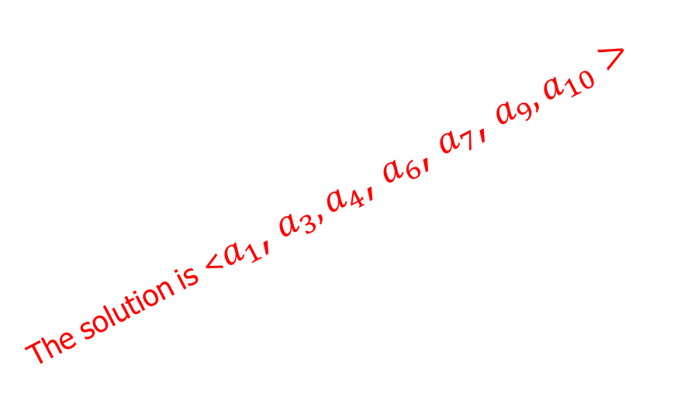
Greedy Algorithm
Problem 1: An activity-selection problem
Solution:
Activity | $$a_{1}$$ | $$a_{3}$$ | $$a_{2}$$ | $$a_{4}$$ | $$a_{6}$$ | $$a_{5}$$ | $$a_{7}$$ | $$a_{9}$$ | $$a_{8}$$ | $$a_{10}$$
$$s_{i}$$ | 1 | 3 | 2 | 4 | 8 | 7 | 9 | 11 | 9 | 12
$$f_{i}$$ | 3 | 4 | 5 | 7 | 9 | 10 | 11 | 12 | 13 | 14
$$a_{10}$$
$$a_{8}$$
$$a_{9}$$
The solution is <$a_{1}$, $a_{3},a_{4}$, $a_{6}$, $a_{7}$, $a_{9},a_{10}>$
$$a_{7}$$
$$a_{5}$$
$$a_{6}$$
$$a_{4}$$
$$a_{2}$$
$$a_{3}$$
$$a_{1}$$
0 | 1 | 2 | 3 | 4 | 5 | 6 | 7 | 8 | 9 | 10 | 11 | 12 | 13 | 14

Slide 24
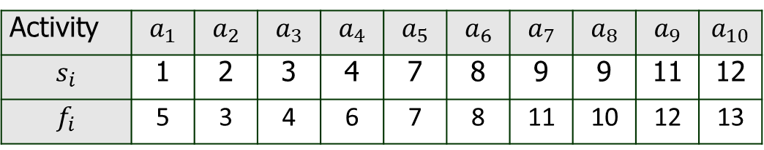
Greedy Algorithm
Problem 1: An activity-selection problem
Example 2: Find the optimal set in the given activity selection problem.
Activity | $$a_{1}$$ | $$a_{2}$$ | $$a_{3}$$ | $$a_{4}$$ | $$a_{5}$$ | $$a_{6}$$ | $$a_{7}$$ | $$a_{8}$$ | $$a_{9}$$ | $$a_{10}$$
$$s_{i}$$ | 1 | 2 | 3 | 4 | 7 | 8 | 9 | 9 | 11 | 12
$$f_{i}$$ | 5 | 3 | 4 | 6 | 7 | 8 | 11 | 10 | 12 | 13

Slide 25
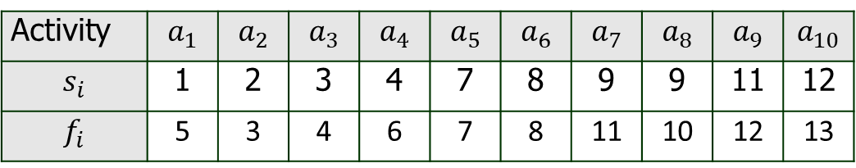

Greedy Algorithm
Problem 1: An activity-selection problem
Solution:
First arraigning the following activities in increasing order on their finishing
Activity | $$a_{1}$$ | $$a_{2}$$ | $$a_{3}$$ | $$a_{4}$$ | $$a_{5}$$ | $$a_{6}$$ | $$a_{7}$$ | $$a_{8}$$ | $$a_{9}$$ | $$a_{10}$$
$$s_{i}$$ | 1 | 2 | 3 | 4 | 7 | 8 | 9 | 9 | 11 | 12
$$f_{i}$$ | 5 | 3 | 4 | 6 | 7 | 8 | 11 | 10 | 12 | 13
Activity | $$a_{2}$$ | $$a_{3}$$ | $$a_{1}$$ | $$a_{4}$$ | $$a_{5}$$ | $$a_{6}$$ | $$a_{8}$$ | $$a_{7}$$ | $$a_{9}$$ | $$a_{10}$$
$$s_{i}$$ | 2 | 3 | 1 | 4 | 5 | 6 | 8 | 7 | 9 | 10
$$f_{i}$$ | 3 | 4 | 5 | 6 | 7 | 8 | 10 | 11 | 12 | 13

Slide 26
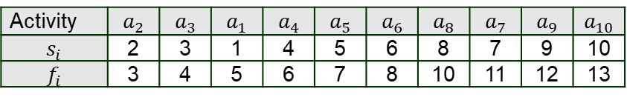

Greedy Algorithm
Problem 1: An activity-selection problem
Solution:
Activity | $$a_{2}$$ | $$a_{3}$$ | $$a_{1}$$ | $$a_{4}$$ | $$a_{5}$$ | $$a_{6}$$ | $$a_{8}$$ | $$a_{7}$$ | $$a_{9}$$ | $$a_{10}$$
$$s_{i}$$ | 2 | 3 | 1 | 4 | 5 | 6 | 8 | 7 | 9 | 10
$$f_{i}$$ | 3 | 4 | 5 | 6 | 7 | 8 | 10 | 11 | 12 | 13
$$a_{2}$$
0 | 1 | 2 | 3 | 4 | 5 | 6 | 7 | 8 | 9 | 10 | 11 | 12 | 13 | 14

Slide 27

Greedy Algorithm
Problem 1: An activity-selection problem
Solution:
Activity | $$a_{2}$$ | $$a_{3}$$ | $$a_{1}$$ | $$a_{4}$$ | $$a_{5}$$ | $$a_{6}$$ | $$a_{8}$$ | $$a_{7}$$ | $$a_{9}$$ | $$a_{10}$$
$$s_{i}$$ | 2 | 3 | 1 | 4 | 5 | 6 | 8 | 7 | 9 | 10
$$f_{i}$$ | 3 | 4 | 5 | 6 | 7 | 8 | 10 | 11 | 12 | 13
$$a_{3}$$
$$a_{2}$$
0 | 1 | 2 | 3 | 4 | 5 | 6 | 7 | 8 | 9 | 10 | 11 | 12 | 13 | 14

Slide 28

Greedy Algorithm
Problem 1: An activity-selection problem
Solution:
Activity | $$a_{2}$$ | $$a_{3}$$ | $$a_{1}$$ | $$a_{4}$$ | $$a_{5}$$ | $$a_{6}$$ | $$a_{8}$$ | $$a_{7}$$ | $$a_{9}$$ | $$a_{10}$$
$$s_{i}$$ | 2 | 3 | 1 | 4 | 5 | 6 | 8 | 7 | 9 | 10
$$f_{i}$$ | 3 | 4 | 5 | 6 | 7 | 8 | 10 | 11 | 12 | 13
$$a_{1}$$
$$a_{3}$$
$$a_{2}$$
0 | 1 | 2 | 3 | 4 | 5 | 6 | 7 | 8 | 9 | 10 | 11 | 12 | 13 | 14

Slide 29

Greedy Algorithm
Problem 1: An activity-selection problem
Solution:
Activity | $$a_{2}$$ | $$a_{3}$$ | $$a_{1}$$ | $$a_{4}$$ | $$a_{5}$$ | $$a_{6}$$ | $$a_{8}$$ | $$a_{7}$$ | $$a_{9}$$ | $$a_{10}$$
$$s_{i}$$ | 2 | 3 | 1 | 4 | 5 | 6 | 8 | 7 | 9 | 10
$$f_{i}$$ | 3 | 4 | 5 | 6 | 7 | 8 | 10 | 11 | 12 | 13
$$a_{4}$$
$$a_{1}$$
$$a_{3}$$
$$a_{2}$$
0 | 1 | 2 | 3 | 4 | 5 | 6 | 7 | 8 | 9 | 10 | 11 | 12 | 13 | 14

Slide 30

Greedy Algorithm
Problem 1: An activity-selection problem
Solution:
Activity | $$a_{2}$$ | $$a_{3}$$ | $$a_{1}$$ | $$a_{4}$$ | $$a_{5}$$ | $$a_{6}$$ | $$a_{8}$$ | $$a_{7}$$ | $$a_{9}$$ | $$a_{10}$$
$$s_{i}$$ | 2 | 3 | 1 | 4 | 5 | 6 | 8 | 7 | 9 | 10
$$f_{i}$$ | 3 | 4 | 5 | 6 | 7 | 8 | 10 | 11 | 12 | 13
$$a_{5}$$
$$a_{4}$$
$$a_{1}$$
$$a_{3}$$
$$a_{2}$$
0 | 1 | 2 | 3 | 4 | 5 | 6 | 7 | 8 | 9 | 10 | 11 | 12 | 13 | 14

Slide 31

Greedy Algorithm
Problem 1: An activity-selection problem
Solution:
Activity | $$a_{2}$$ | $$a_{3}$$ | $$a_{1}$$ | $$a_{4}$$ | $$a_{5}$$ | $$a_{6}$$ | $$a_{8}$$ | $$a_{7}$$ | $$a_{9}$$ | $$a_{10}$$
$$s_{i}$$ | 2 | 3 | 1 | 4 | 5 | 6 | 8 | 7 | 9 | 10
$$f_{i}$$ | 3 | 4 | 5 | 6 | 7 | 8 | 10 | 11 | 12 | 13
$$a_{6}$$
$$a_{5}$$
$$a_{4}$$
$$a_{1}$$
$$a_{3}$$
$$a_{2}$$
0 | 1 | 2 | 3 | 4 | 5 | 6 | 7 | 8 | 9 | 10 | 11 | 12 | 13 | 14

Slide 32

Greedy Algorithm
Problem 1: An activity-selection problem
Solution:
Activity | $$a_{2}$$ | $$a_{3}$$ | $$a_{1}$$ | $$a_{4}$$ | $$a_{5}$$ | $$a_{6}$$ | $$a_{8}$$ | $$a_{7}$$ | $$a_{9}$$ | $$a_{10}$$
$$s_{i}$$ | 2 | 3 | 1 | 4 | 5 | 6 | 8 | 7 | 9 | 10
$$f_{i}$$ | 3 | 4 | 5 | 6 | 7 | 8 | 10 | 11 | 12 | 13
$$a_{8}$$
$$a_{6}$$
$$a_{5}$$
$$a_{4}$$
$$a_{1}$$
$$a_{3}$$
$$a_{2}$$
0 | 1 | 2 | 3 | 4 | 5 | 6 | 7 | 8 | 9 | 10 | 11 | 12 | 13 | 14

Slide 33

Greedy Algorithm
Problem 1: An activity-selection problem
Solution:
Activity | $$a_{2}$$ | $$a_{3}$$ | $$a_{1}$$ | $$a_{4}$$ | $$a_{5}$$ | $$a_{6}$$ | $$a_{8}$$ | $$a_{7}$$ | $$a_{9}$$ | $$a_{10}$$
$$s_{i}$$ | 2 | 3 | 1 | 4 | 5 | 6 | 8 | 7 | 9 | 10
$$f_{i}$$ | 3 | 4 | 5 | 6 | 7 | 8 | 10 | 11 | 12 | 13
$$a_{7}$$
$$a_{8}$$
$$a_{6}$$
$$a_{5}$$
$$a_{4}$$
$$a_{1}$$
$$a_{3}$$
$$a_{2}$$
0 | 1 | 2 | 3 | 4 | 5 | 6 | 7 | 8 | 9 | 10 | 11 | 12 | 13 | 14

Slide 34

Greedy Algorithm
Problem 1: An activity-selection problem
Solution:
Activity | $$a_{2}$$ | $$a_{3}$$ | $$a_{1}$$ | $$a_{4}$$ | $$a_{5}$$ | $$a_{6}$$ | $$a_{8}$$ | $$a_{7}$$ | $$a_{9}$$ | $$a_{10}$$
$$s_{i}$$ | 2 | 3 | 1 | 4 | 5 | 6 | 8 | 7 | 9 | 10
$$f_{i}$$ | 3 | 4 | 5 | 6 | 7 | 8 | 10 | 11 | 12 | 13
$$a_{9}$$
$$a_{7}$$
$$a_{8}$$
$$a_{6}$$
$$a_{5}$$
$$a_{4}$$
$$a_{1}$$
$$a_{3}$$
$$a_{2}$$
0 | 1 | 2 | 3 | 4 | 5 | 6 | 7 | 8 | 9 | 10 | 11 | 12 | 13 | 14

Slide 35

Greedy Algorithm
Problem 1: An activity-selection problem
Solution:
Activity | $$a_{2}$$ | $$a_{3}$$ | $$a_{1}$$ | $$a_{4}$$ | $$a_{5}$$ | $$a_{6}$$ | $$a_{8}$$ | $$a_{7}$$ | $$a_{9}$$ | $$a_{10}$$
$$s_{i}$$ | 2 | 3 | 1 | 4 | 5 | 6 | 8 | 7 | 9 | 10
$$f_{i}$$ | 3 | 4 | 5 | 6 | 7 | 8 | 10 | 11 | 12 | 13
$$a_{10}$$
$$a_{9}$$
$$a_{7}$$
$$a_{8}$$
$$a_{6}$$
$$a_{5}$$
$$a_{4}$$
$$a_{1}$$
$$a_{3}$$
$$a_{2}$$
0 | 1 | 2 | 3 | 4 | 5 | 6 | 7 | 8 | 9 | 10 | 11 | 12 | 13 | 14

Slide 36
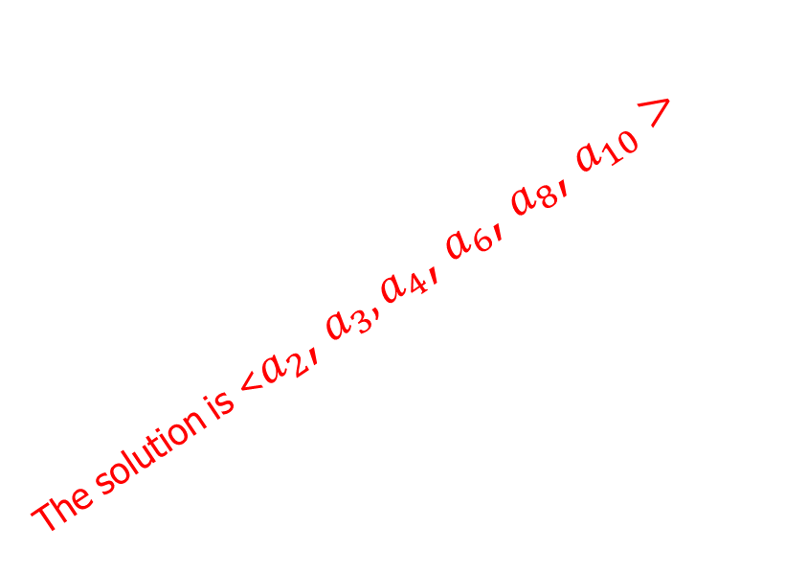
Greedy Algorithm
Problem 1: An activity-selection problem
Solution:
Activity | $$a_{2}$$ | $$a_{3}$$ | $$a_{1}$$ | $$a_{4}$$ | $$a_{5}$$ | $$a_{6}$$ | $$a_{8}$$ | $$a_{7}$$ | $$a_{9}$$ | $$a_{10}$$
$$s_{i}$$ | 2 | 3 | 1 | 4 | 5 | 6 | 8 | 7 | 9 | 10
$$f_{i}$$ | 3 | 4 | 5 | 6 | 7 | 8 | 10 | 11 | 12 | 13
$$a_{10}$$
$$a_{9}$$
$$a_{7}$$
$$a_{8}$$
The solution is <$a_{2}$, $a_{3},a_{4}$, $a_{6}$, $a_{8}$, $a_{10}>$
$$a_{6}$$
$$a_{5}$$
$$a_{4}$$
$$a_{1}$$
$$a_{3}$$
$$a_{2}$$
0 | 1 | 2 | 3 | 4 | 5 | 6 | 7 | 8 | 9 | 10 | 11 | 12 | 13 | 14

Slide 37
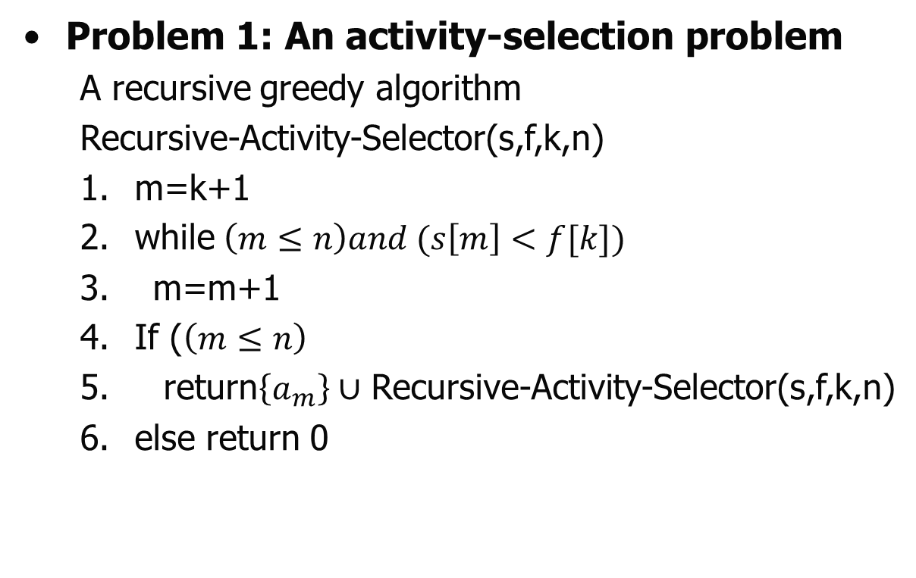
Greedy Algorithm
Problem 1: An activity-selection problem
A recursive greedy algorithm
Recursive-Activity-Selector(s,f,k,n)
1. m=k+1
2. while$\left(m≤n\right)and (s\left[m\right]<f[k])$
3. m=m+1
4. If ($\left(m≤n\right)$
5. return$\left\{a_{m}\right\}∪$ Recursive-Activity-Selector(s,f,k,n)
6. else return 0

Slide 38
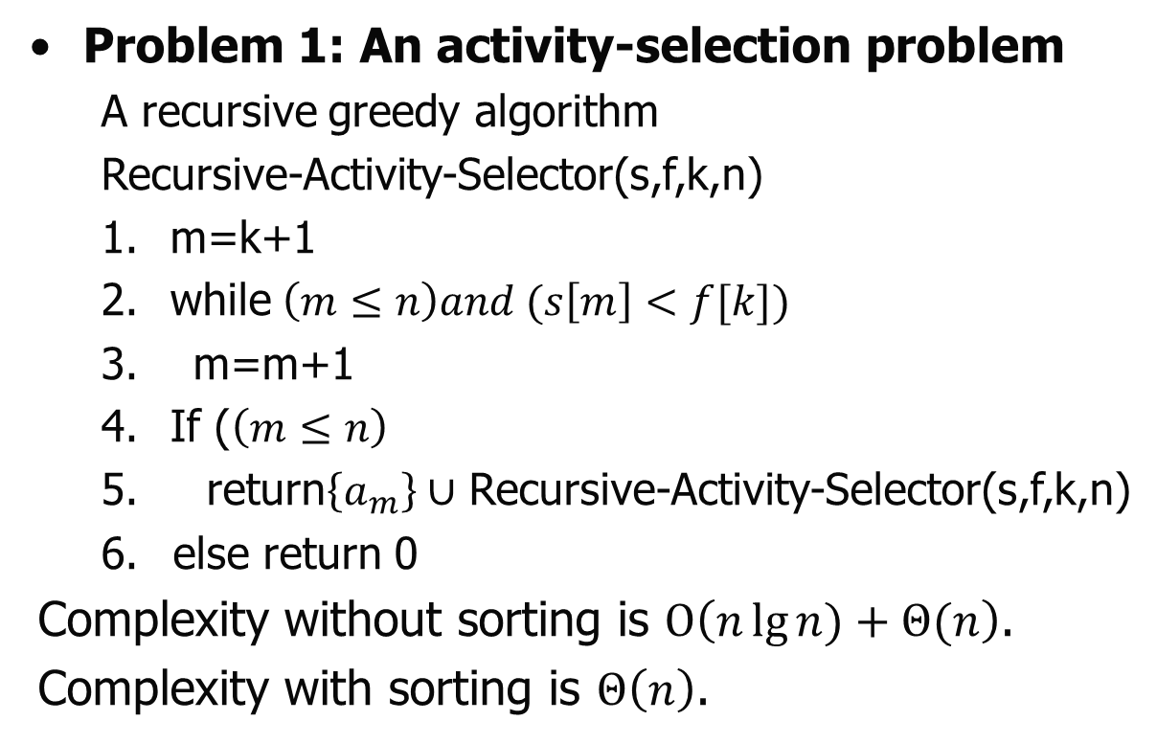
Greedy Algorithm
Problem 1: An activity-selection problem
A recursive greedy algorithm
Recursive-Activity-Selector(s,f,k,n)
1. m=k+1
2. while$\left(m≤n\right)and (s\left[m\right]<f[k])$
3. m=m+1
4. If ($\left(m≤n\right)$
5. return$\left\{a_{m}\right\}∪$ Recursive-Activity-Selector(s,f,k,n)
else return 0
Complexity without sorting is $Ο\left(n\lg{n)+Θ(n}\right)$.
Complexity with sorting is $Θ\left(n\right)$.

Slide 39
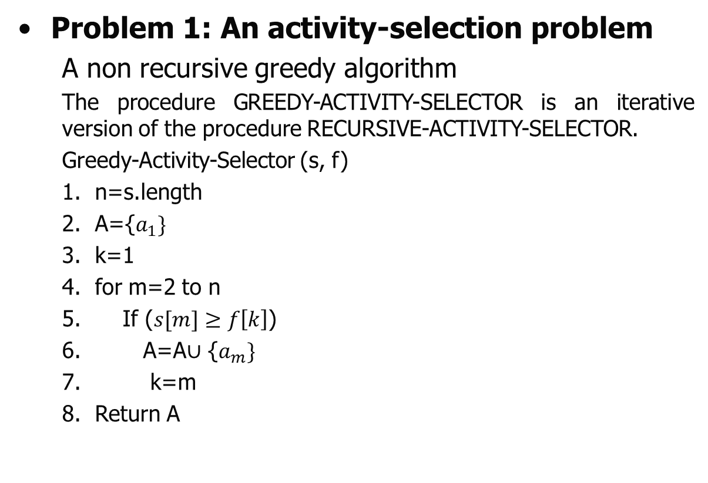
Greedy Algorithm
Problem 1: An activity-selection problem
A non recursive greedy algorithm
The procedure GREEDY-ACTIVITY-SELECTOR is an iterative version of the procedure RECURSIVE-ACTIVITY-SELECTOR.
Greedy-Activity-Selector (s, f)
n=s.length
A={$a_{1}\}$
k=1
for m=2 to n
If ($s[m]≥f\left[k\right]$)
A=A$∪$ {$a_{m}\}$
k=m
Return A

Slide 40
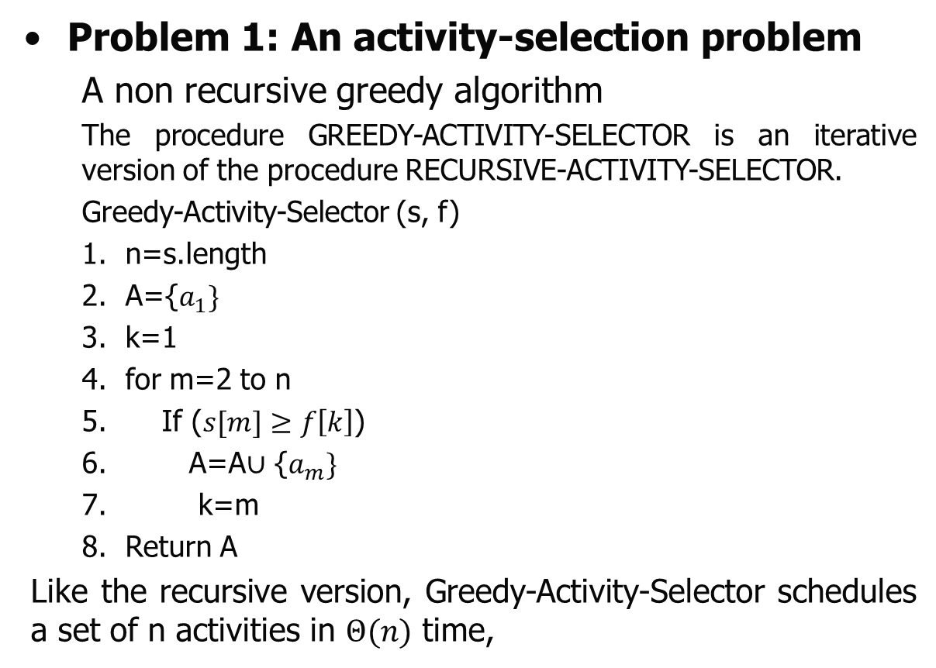
Greedy Algorithm
Problem 1: An activity-selection problem
A non recursive greedy algorithm
The procedure GREEDY-ACTIVITY-SELECTOR is an iterative version of the procedure RECURSIVE-ACTIVITY-SELECTOR.
Greedy-Activity-Selector (s, f)
n=s.length
A={$a_{1}\}$
k=1
for m=2 to n
If ($s[m]≥f\left[k\right]$)
A=A$∪$ {$a_{m}\}$
k=m
Return A
Like the recursive version, Greedy-Activity-Selector schedules a set of n activities in $Θ(n)$ time,

Slide 41
Greedy Algorithm
Problem 2: Task Scheduling problem
An interesting problem that are solving using matroids is the problem of optimally scheduling unit-time tasks on a single processor, where each task has a deadline, along with a penalty paid if the task misses its deadline.
This problem looks complicated, when it was solved in a surprisingly simple manner by casting it as a matroid and using a greedy algorithm.

Slide 42
Greedy Algorithm
Problem 2: Task Scheduling problem
A unit-time task is a job, such as a program to be run on a computer, that requires exactly one unit of time to complete.
Given a finite set S of unit-time tasks, a schedule for S is a permutation of S specifying the order in which to perform these tasks.
The first task in the schedule begins at time 0 and finishes at time 1, the second task begins at time 1 and finishes at time 2, and so on..

Slide 43
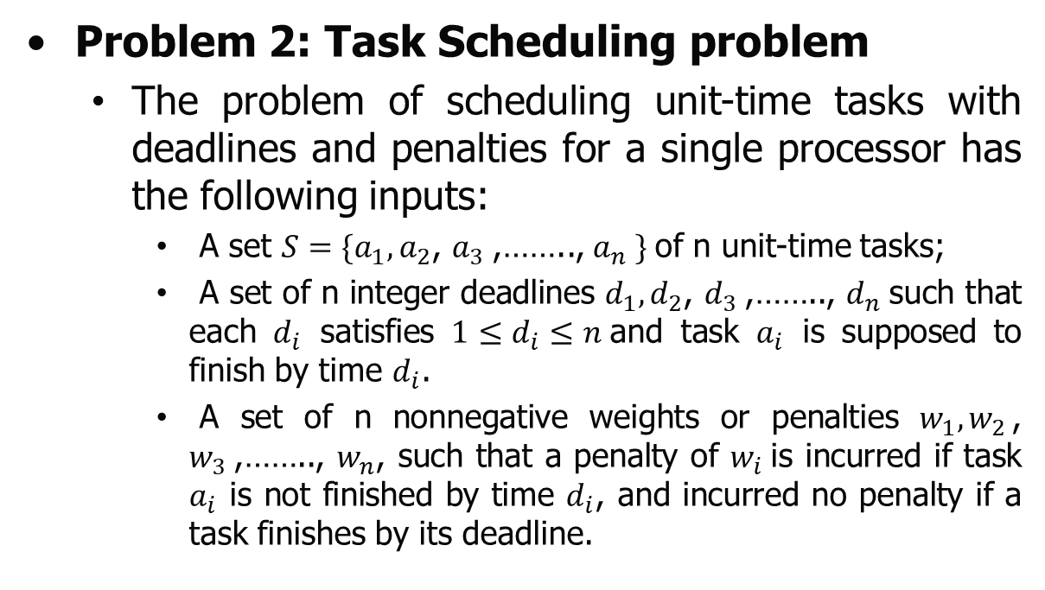
Greedy Algorithm
Problem 2: Task Scheduling problem
The problem of scheduling unit-time tasks with deadlines and penalties for a single processor has the following inputs:
A set $S=\{a_{1},a_{2}$, $a_{3}$,…….., $a_{n} \}$of n unit-time tasks;
A set of n integer deadlines $d_{1},d_{2}$, $d_{3}$,…….., $d_{n}$such that each $d_{i}$ satisfies ${1≤d}_{i}≤n$and task $a_{i}$ is supposed to finish by time $d_{i}$.
A set of n nonnegative weights or penalties $w_{1},w_{2}$, $w_{3}$,…….., $w_{n}$, such that a penalty of $w_{i}$is incurred if task $a_{i}$ is not finished by time $d_{i}$, and incurred no penalty if a task finishes by its deadline.

Slide 44
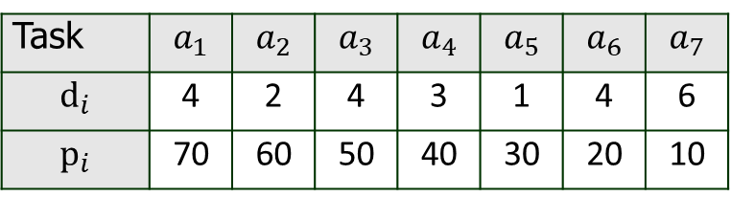
Greedy Algorithm
Problem 2: Task Scheduling problem
Example 1: Find an optimal schedule from the following table, where the tasks with penalties(weight) and deadlines are given.
Task | $$a_{1}$$ | $$a_{2}$$ | $$a_{3}$$ | $$a_{4}$$ | $$a_{5}$$ | $$a_{6}$$ | $$a_{7}$$
$$d_{i}$$ | 4 | 2 | 4 | 3 | 1 | 4 | 6
$$p_{i}$$ | 70 | 60 | 50 | 40 | 30 | 20 | 10

Slide 45
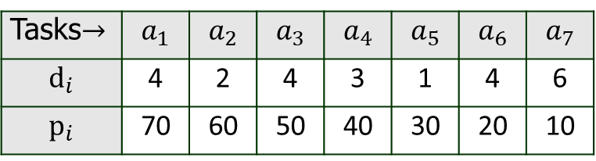
Greedy Algorithm
Problem 2: Task Scheduling problem
Example 1:
Solution: As per the greedy algorithm, first sort the tasks in descending order of their penalties. So that minimum penalties will be charged.
(Note: In this problem the tasks are already sorted)
Tasks$→$ | $$a_{1}$$ | $$a_{2}$$ | $$a_{3}$$ | $$a_{4}$$ | $$a_{5}$$ | $$a_{6}$$ | $$a_{7}$$
$$d_{i}$$ | 4 | 2 | 4 | 3 | 1 | 4 | 6
$$p_{i}$$ | 70 | 60 | 50 | 40 | 30 | 20 | 10

Slide 46

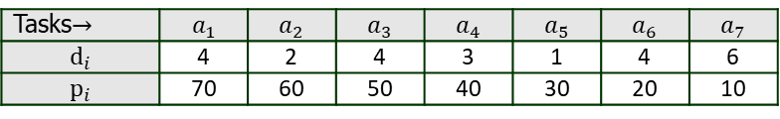
Greedy Algorithm
Problem 1: An activity-selection problem
Solution:
Tasks$→$ | $$a_{1}$$ | $$a_{2}$$ | $$a_{3}$$ | $$a_{4}$$ | $$a_{5}$$ | $$a_{6}$$ | $$a_{7}$$
$$d_{i}$$ | 4 | 2 | 4 | 3 | 1 | 4 | 6
$$p_{i}$$ | 70 | 60 | 50 | 40 | 30 | 20 | 10
$$a_{1}$$
0 | 1 | 2 | 3 | 4 | 5 | 6 | 7 | 8 | 9 | 10 | 11 | 12 | 13 | 14

Slide 47

Greedy Algorithm
Problem 1: An activity-selection problem
Solution:
Tasks$→$ | $$a_{1}$$ | $$a_{2}$$ | $$a_{3}$$ | $$a_{4}$$ | $$a_{5}$$ | $$a_{6}$$ | $$a_{7}$$
$$d_{i}$$ | 4 | 2 | 4 | 3 | 1 | 4 | 6
$$p_{i}$$ | 70 | 60 | 50 | 40 | 30 | 20 | 10
$$a_{2}$$
$$a_{1}$$
0 | 1 | 2 | 3 | 4 | 5 | 6 | 7 | 8 | 9 | 10 | 11 | 12 | 13 | 14

Slide 48

Greedy Algorithm
Problem 1: An activity-selection problem
Solution:
Tasks$→$ | $$a_{1}$$ | $$a_{2}$$ | $$a_{3}$$ | $$a_{4}$$ | $$a_{5}$$ | $$a_{6}$$ | $$a_{7}$$
$$d_{i}$$ | 4 | 2 | 4 | 3 | 1 | 4 | 6
$$p_{i}$$ | 70 | 60 | 50 | 40 | 30 | 20 | 10
$$a_{3}$$
$$a_{2}$$
$$a_{1}$$
0 | 1 | 2 | 3 | 4 | 5 | 6 | 7 | 8 | 9 | 10 | 11 | 12 | 13 | 14

Slide 49

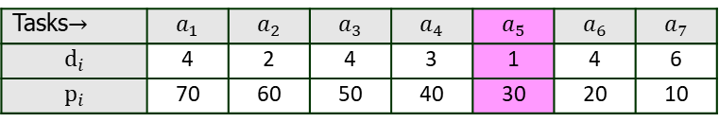
Greedy Algorithm
Problem 1: An activity-selection problem
Solution:
Tasks$→$ | $$a_{1}$$ | $$a_{2}$$ | $$a_{3}$$ | $$a_{4}$$ | $$a_{5}$$ | $$a_{6}$$ | $$a_{7}$$
$$d_{i}$$ | 4 | 2 | 4 | 3 | 1 | 4 | 6
$$p_{i}$$ | 70 | 60 | 50 | 40 | 30 | 20 | 10
Can’t place
$$a_{4}$$
$$a_{3}$$
$$a_{2}$$
$$a_{1}$$
0 | 1 | 2 | 3 | 4 | 5 | 6 | 7 | 8 | 9 | 10 | 11 | 12 | 13 | 14

Slide 50
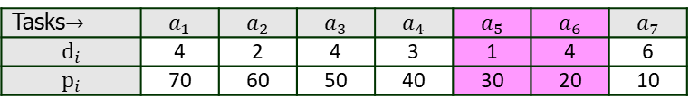
Greedy Algorithm
Problem 1: An activity-selection problem
Solution:
Tasks$→$ | $$a_{1}$$ | $$a_{2}$$ | $$a_{3}$$ | $$a_{4}$$ | $$a_{5}$$ | $$a_{6}$$ | $$a_{7}$$
$$d_{i}$$ | 4 | 2 | 4 | 3 | 1 | 4 | 6
$$p_{i}$$ | 70 | 60 | 50 | 40 | 30 | 20 | 10
Can’t place
$$a_{4}$$
$$a_{3}$$
$$a_{2}$$
$$a_{1}$$
0 | 1 | 2 | 3 | 4 | 5 | 6 | 7 | 8 | 9 | 10 | 11 | 12 | 13 | 14

Slide 51

Greedy Algorithm
Problem 1: An activity-selection problem
Solution:
Tasks$→$ | $$a_{1}$$ | $$a_{2}$$ | $$a_{3}$$ | $$a_{4}$$ | $$a_{5}$$ | $$a_{6}$$ | $$a_{7}$$
$$d_{i}$$ | 4 | 2 | 4 | 3 | 1 | 4 | 6
$$p_{i}$$ | 70 | 60 | 50 | 40 | 30 | 20 | 10
$$a_{7}$$
$$a_{4}$$
$$a_{3}$$
$$a_{2}$$
$$a_{1}$$
0 | 1 | 2 | 3 | 4 | 5 | 6 | 7 | 8 | 9 | 10 | 11 | 12 | 13 | 14

Slide 52

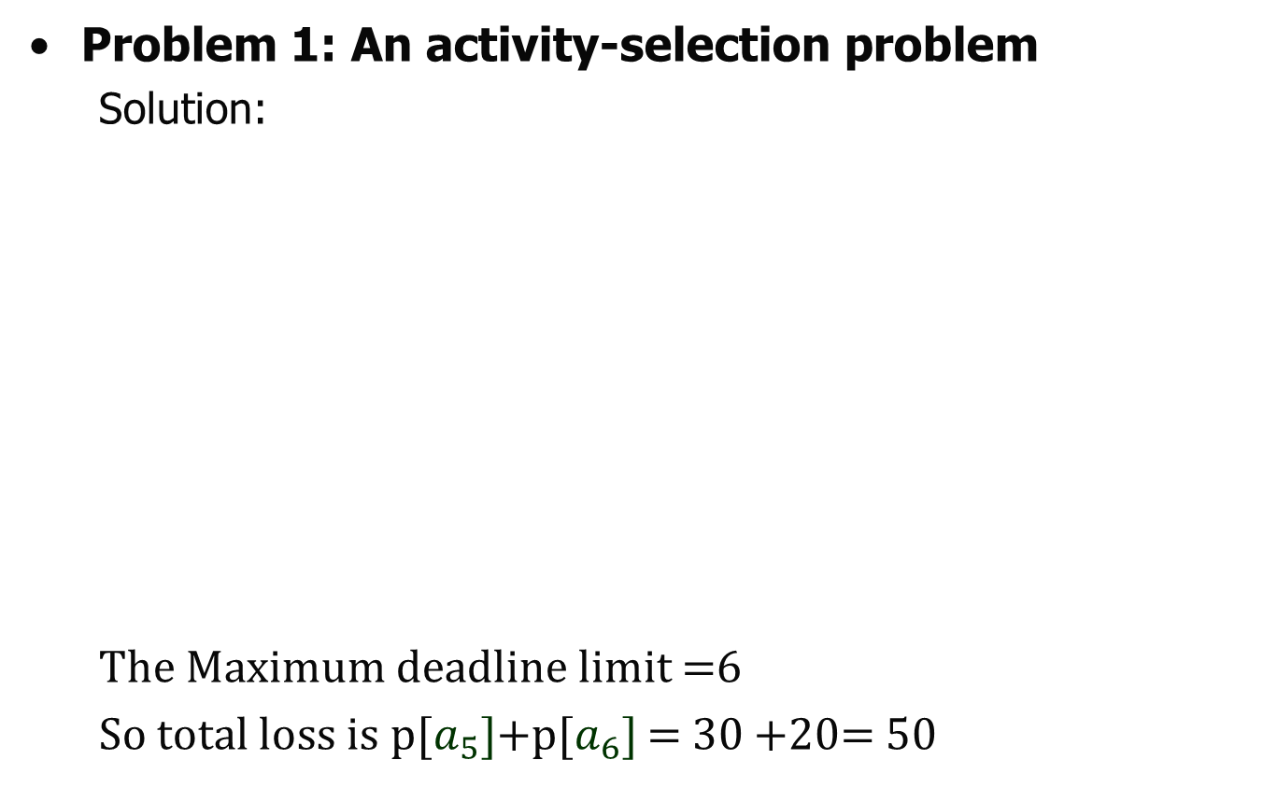





Greedy Algorithm
Problem 1: An activity-selection problem
Solution:
The Maximum deadline limit =6
So total loss is p[$a_{5}]$+p[$a_{6}]$ = 30 +20= 50
Tasks$→$ | $$a_{1}$$ | $$a_{2}$$ | $$a_{3}$$ | $$a_{4}$$ | $$a_{5}$$ | $$a_{6}$$ | $$a_{7}$$
$$d_{i}$$ | 4 | 2 | 4 | 3 | 1 | 4 | 6
$$p_{i}$$ | 70 | 60 | 50 | 40 | 30 | 20 | 10
$$a_{7}$$
$$a_{4}$$
Gantt Chart
$$a_{3}$$
$$a_{4}$$ | $$a_{2}$$ | $$a_{3}$$ | $$a_{1}$$ |  | $$a_{7}$$
$$a_{2}$$
$$a_{1}$$
0 | 1 | 2 | 3 | 4 | 5 | 6

Slide 53
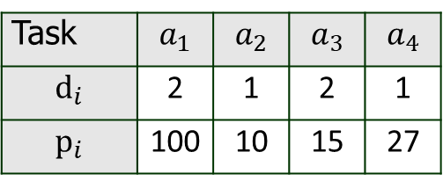
Greedy Algorithm
Problem 2: Task Scheduling problem
Example 2: Find an optimal schedule from the following table, where the tasks with penalties(weight) and deadlines are given.
Task | $$a_{1}$$ | $$a_{2}$$ | $$a_{3}$$ | $$a_{4}$$
$$d_{i}$$ | 2 | 1 | 2 | 1
$$p_{i}$$ | 100 | 10 | 15 | 27

Slide 54
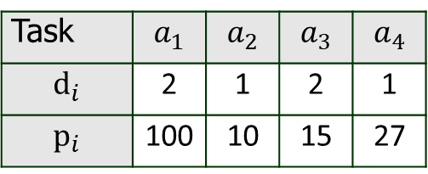
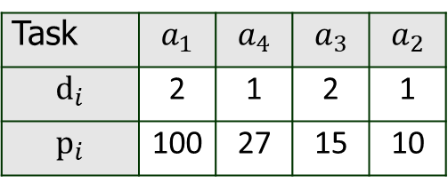
Greedy Algorithm
Problem 2: Task Scheduling problem
Example 2:
Solution: As per the greedy algorithm, first sort the tasks in descending order of their penalties. So that minimum penalties will be charged.
Task | $$a_{1}$$ | $$a_{2}$$ | $$a_{3}$$ | $$a_{4}$$
$$d_{i}$$ | 2 | 1 | 2 | 1
$$p_{i}$$ | 100 | 10 | 15 | 27
Task | $$a_{1}$$ | $$a_{4}$$ | $$a_{3}$$ | $$a_{2}$$
$$d_{i}$$ | 2 | 1 | 2 | 1
$$p_{i}$$ | 100 | 27 | 15 | 10
After Sorting

Slide 55

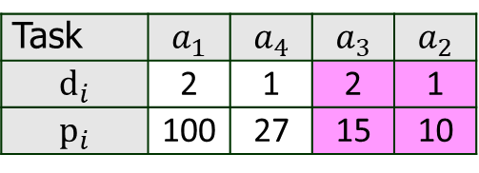


Greedy Algorithm
Problem 1: An activity-selection problem
Solution:
The Maximum deadline limit =2
So total loss is p[$a_{3}]$+p[$a_{2}]$ = 15 +10= 25
Task | $$a_{1}$$ | $$a_{4}$$ | $$a_{3}$$ | $$a_{2}$$
$$d_{i}$$ | 2 | 1 | 2 | 1
$$p_{i}$$ | 100 | 27 | 15 | 10
$$a_{4}$$
Gantt Chart
Can’t place
$$a_{4}$$ | $$a_{1}$$
$$a_{1}$$
0 | 1 | 2 | 3 | 4 | 5 | 6

Slide 56

Greedy Algorithm
Problem 2: Task Scheduling problem
Example 3: Find an optimal schedule from the following table, where the tasks with penalties(weight) and deadlines are given.
Task | $$a_{1}$$ | $$a_{2}$$ | $$a_{3}$$ | $$a_{4}$$ | $$a_{5}$$ | $$a_{6}$$ | $$a_{7}$$
$$d_{i}$$ | 1 | 3 | 3 | 4 | 1 | 2 | 1
$$p_{i}$$ | 3 | 5 | 18 | 20 | 6 | 1 | 38

Slide 57
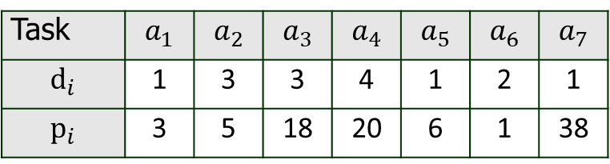
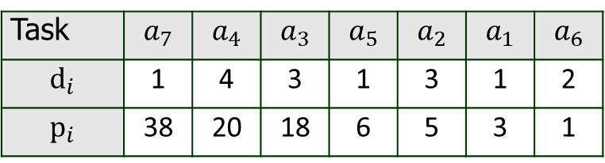
Greedy Algorithm
Problem 2: Task Scheduling problem
Example 3:
Solution: As per the greedy algorithm, first sort the tasks in descending order of their penalties. So that minimum penalties will be charged.
Task | $$a_{1}$$ | $$a_{2}$$ | $$a_{3}$$ | $$a_{4}$$ | $$a_{5}$$ | $$a_{6}$$ | $$a_{7}$$
$$d_{i}$$ | 1 | 3 | 3 | 4 | 1 | 2 | 1
$$p_{i}$$ | 3 | 5 | 18 | 20 | 6 | 1 | 38
Task | $$a_{7}$$ | $$a_{4}$$ | $$a_{3}$$ | $$a_{5}$$ | $$a_{2}$$ | $$a_{1}$$ | $$a_{6}$$
$$d_{i}$$ | 1 | 4 | 3 | 1 | 3 | 1 | 2
$$p_{i}$$ | 38 | 20 | 18 | 6 | 5 | 3 | 1

Slide 58

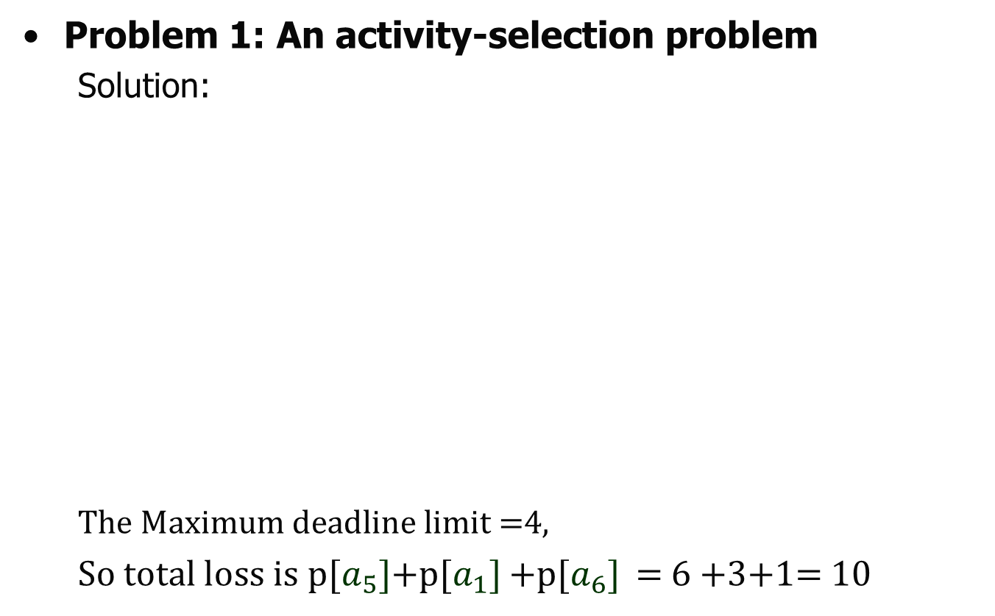


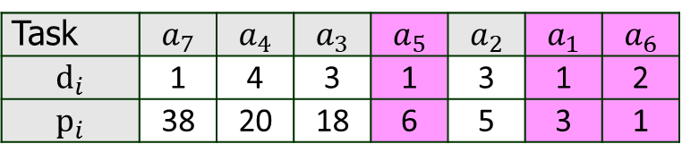
Greedy Algorithm
Problem 1: An activity-selection problem
Solution:
The Maximum deadline limit =4,
So total loss is p[$a_{5}]$+p[$a_{1}]$ +p[$a_{6}]$ = 6 +3+1= 10
Task | $$a_{7}$$ | $$a_{4}$$ | $$a_{3}$$ | $$a_{5}$$ | $$a_{2}$$ | $$a_{1}$$ | $$a_{6}$$
$$d_{i}$$ | 1 | 4 | 3 | 1 | 3 | 1 | 2
$$p_{i}$$ | 38 | 20 | 18 | 6 | 5 | 3 | 1
Can’t place
$$a_{7}$$
Gantt Chart
$$a_{3}$$
$$a_{7}$$ | $$a_{2}$$ | $$a_{3}$$ | $$a_{4}$$
$$a_{2}$$
$$a_{4}$$
0 | 1 | 2 | 3 | 4

Slide 59
Greedy Algorithm
Problem 3: Huffman Coding
Huffman Coding is a famous Greedy Algorithm.
It is used for the lossless compression of data.
It uses variable length encoding.
It assigns variable length code to all the characters.
The code length of a character depends on how frequently it occurs in the given text.
The character which occurs most frequently gets the smallest code.
The character which occurs least frequently gets the largest code.
It is also known as Huffman Encoding

Slide 60
Greedy Algorithm
Problem 3: Huffman Coding
Huffman Coding implements a rule known as a prefix rule.
This is to prevent the ambiguities while decoding.
It ensures that the code assigned to any character is not a prefix of the code assigned to any other character.

Slide 61
Greedy Algorithm
Problem 3: Huffman Coding
Major Steps in Huffman Coding-
There are two major steps in Huffman Coding-
Building a Huffman Tree from the input characters.
Assigning code to the characters by traversing the Huffman Tree.

Slide 62
Greedy Algorithm
Problem 3: Huffman Coding
Building a Huffman Tree from the input characters.
The steps involved in the construction of Huffman Tree are as follows-
Step-01:
Create a leaf node for each character of the text.
Leaf node of a character contains the occurring frequency of that character.
Step-02:
Arrange all the nodes in increasing order of their frequency value.

Slide 63
Greedy Algorithm
Problem 3: Huffman Coding
Building a Huffman Tree from the input characters.
Step-03:
Considering the first two nodes having minimum frequency,
Create a new internal node.
The frequency of this new node is the sum of frequency of those two nodes.
Make the first node as a left child and the other node as a right child of the newly created node.
Step-04:
Keep repeating Step-02 and Step-03 until all the nodes form a single tree.
The tree finally obtained is the desired Huffman Tree.

Slide 64
Greedy Algorithm
Problem 3: Huffman Coding
Building a Huffman Tree from the input characters.
Time Complexity-
The time complexity analysis of Huffman Coding is as follows-
extractMin( ) is called 2 x (n-1) times if there are n nodes.
As extractMin( ) calls minHeapify( ), it takes O(logn) time.
Thus, Overall time complexity of Huffman Coding becomes O(nlogn).
[Note: Here, n is the number of unique characters in the given text.]

Slide 65
Greedy Algorithm
Problem 3: Huffman Coding
Assigning code to the characters by traversing the Huffman Tree.
Assign weight to all the edges of the constructed Huffman Tree.
Let us assign weight ‘0’ to the left edges and weight ‘1’ to the right edges.

Slide 66
Greedy Algorithm
Problem 3: Huffman Coding
Assigning code to the characters by traversing the Huffman Tree.
Assign weight to all the edges of the constructed Huffman Tree.
Let us assign weight ‘0’ to the left edges and weight ‘1’ to the right edges.
Rule
If you assign weight ‘0’ to the left edges, then assign weight ‘1’ to the right edges.
If you assign weight ‘1’ to the left edges, then assign weight ‘0’ to the right edges.
Any of the above two conventions may be followed.
But follow the same convention at the time of decoding that is adopted at the time of encoding.

Slide 67
Greedy Algorithm
Problem 3: Huffman Coding
Example 1-
A file contains the following characters with the frequencies as shown. If Huffman Coding is used for data compression, determine-
Huffman Code for each character
Average code length
Length of Huffman encoded message (in bits)
Characters | Frequencies
a | 10
e | 15
i | 12
o | 3
u | 4
s | 13
t | 1

Slide 68
Greedy Algorithm
Problem 3: Huffman Coding
Example 1-
Solution
First let us construct the Huffman Tree.
Huffman Tree is constructed in the following steps-
Step 1:
1
3
4
10
12
13
15
t
o
u
a
i
s
e

Slide 69
Greedy Algorithm
Problem 3: Huffman Coding
Example 1-
Solution
Step 2:
4
4
10
12
13
15
u
a
i
s
e
1
3
t
o

Slide 70
Greedy Algorithm
Problem 3: Huffman Coding
Example 1-
Solution
Step 3:
8
10
12
13
15
a
i
s
e
4
4
u
1
3
t
o

Slide 71
Greedy Algorithm
Problem 3: Huffman Coding
Example 1-
Solution
Step 4:
18
12
10
13
15
i
a
s
e
8
10
a
4
4
u
1
3
t
o

Slide 72
Greedy Algorithm
Problem 3: Huffman Coding
Example 1-
Solution
Step 6:
12
13
15
18
i
s
e
8
10
a
4
4
u
1
3
t
o

Slide 73
Greedy Algorithm
Problem 3: Huffman Coding
Example 1-
Solution
Step 7:
25
15
18
e
12
13
8
10
i
s
a
4
4
u
1
3
t
o

Slide 74
Greedy Algorithm
Problem 3: Huffman Coding
Example 1-
Solution
Step 8:
15
18
25
e
8
10
12
13
a
i
s
4
4
u
1
3
t
o

Slide 75
Greedy Algorithm
Problem 3: Huffman Coding
Example 1-
Solution
Step 9:
33
25
15
18
12
13
e
i
s
8
10
a
4
4
u
1
3
t
o

Slide 76
Greedy Algorithm
Problem 3: Huffman Coding
Example 1-
Solution
Step 10:
25
33
12
13
15
18
i
s
e
8
10
a
4
4
u
1
3
t
o

Slide 77
Greedy Algorithm
Problem 3: Huffman Coding
Example 1-
Solution
58
Step 10:
25
33
12
13
15
18
i
s
e
8
10
a
4
4
u
1
3
t
o

Slide 78
Greedy Algorithm
Now, as per the rule assign weight ‘0’ to the left edges and weight ‘1’ to the right edges.
Problem 3: Huffman Coding
Example 1-
Solution
58
Step 10:
25
33
12
13
15
18
i
s
e
8
10
a
4
4
u
1
3
t
o

Slide 79
Greedy Algorithm
Problem 3: Huffman Coding
Example 1-
Solution
0
58
1
Step 10:
25
33
0
1
0
1
12
13
15
18
i
s
e
0
1
8
10
0
1
a
4
4
0
1
u
1
3
t
o

Slide 80
Greedy Algorithm
Now, answer all the questions
Problem 3: Huffman Coding
Example 1-
Solution
0
58
1
Step 10:
25
33
0
1
0
1
12
13
15
18
i
s
e
0
1
8
10
0
1
a
4
4
0
1
u
1
3
t
o

Slide 81
Greedy Algorithm
Problem 3: Huffman Coding
Example 1-
Solution
Question 1: Huffman Code for each character.
Characters | Frequencies | Huffman Code
a | 10 | 111
e | 15 | 10
i | 12 | 00
o | 3 | 11001
u | 4 | 1101
s | 13 | 01
t | 1 | 11000
0
58
1
25
33
0
1
0
1
12
13
15
18
i
s
e
0
1
8
10
0
1
a
4
4
0
1
u
1
3
t
o
Huffman Tree

Slide 82
Greedy Algorithm
Problem 3: Huffman Coding
Example 1-
Solution
Question 1: Huffman Code for each character.
Characters | Frequencies | Huffman Code
a | 10 | 111
e | 15 | 10
i | 12 | 00
o | 3 | 11001
u | 4 | 1101
s | 13 | 01
t | 1 | 11000
0
58
1
25
33
0
1
0
1
12
13
15
18
i
s
e
0
1
8
10
0
1
a
4
4
0
1
u
Observation:
Characters occurring less frequently in the text are assigned the larger code.
Characters occurring more frequently in the text are assigned the smaller code.
1
3
t
o
Huffman Tree

Slide 83
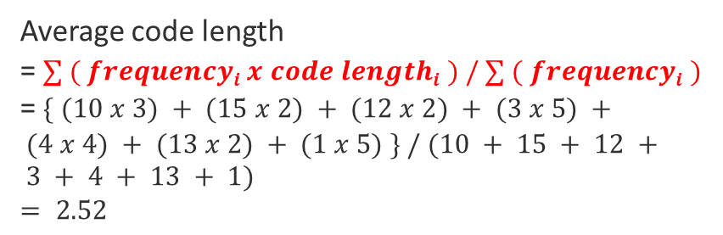
Greedy Algorithm
Problem 3: Huffman Coding
Example 1-
Solution
Question 2: Average code length
.
Characters | Frequencies | Huffman Code
a | 10 | 111
e | 15 | 10
i | 12 | 00
o | 3 | 11001
u | 4 | 1101
s | 13 | 01
t | 1 | 11000
0
58
1
25
33
0
0
1
1
12
13
15
18
i
s
e
0
1
8
10
0
1
a
Average code length
= $∑ ( frequencyi x code lengthi ) / ∑ ( frequencyi )$
= $\{ (10 x 3) + (15 x 2) + (12 x 2) + (3 x 5) + (4 x 4) + (13 x 2) + (1 x 5) \} / (10 + 15 + 12 + 3 + 4 + 13 + 1)$
$$= 2.52$$
4
4
0
1
u
1
3
t
o
Huffman Tree

Slide 84
Greedy Algorithm
Problem 3: Huffman Coding
Example 1-
Solution
Question 3: Length of Huffman encoded message (in bits)
.
Characters | Frequencies | Huffman Code
a | 10 | 111
e | 15 | 10
i | 12 | 00
o | 3 | 11001
u | 4 | 1101
s | 13 | 01
t | 1 | 11000
0
58
1
25
33
0
0
1
1
12
13
15
18
i
s
e
0
1
8
10
0
1
a
Total number of bits in Huffman encoded message
= Total number of characters in the message x Average code length per character
= 58 x 2.52
= 146.16
≅ 147 bits
4
4
0
1
u
1
3
t
o
Huffman Tree

Slide 85
Greedy Algorithm
Problem 3: Huffman Coding (Algorithm)
HUFFMAN(C)
1 n ← |C|
2 Q ← C
3 for i 1 to n - 1
4 do allocate a new node z
5 left[z] ← x ← EXTRACT-MIN (Q)
6 right[z] ← y ← EXTRACT-MIN (Q)
7 f [z] ← f [x] + f [y]
8 INSERT(Q, z)
9 return EXTRACT-MIN(Q)

Slide 86
Greedy Algorithm
Problem 3: Huffman Coding (Algorithm)
HUFFMAN(C)
1 n ← |C|
2 Q ← C
3 for i 1 to n - 1
4 do allocate a new node z
5 left[z] ← x ← EXTRACT-MIN (Q)
6 right[z] ← y ← EXTRACT-MIN (Q)
7 f [z] ← f [x] + f [y]
8 INSERT(Q, z)
9 return EXTRACT-MIN(Q)
The total running time of HUFFMAN on a set of n characters is O (n lg n).

Slide 87
Greedy Algorithm
Problem 3: Huffman Coding
Example 2-
A file contains the following characters with the frequencies as shown. If Huffman Coding is used for data compression, determine-
Huffman Code for each character
Average code length
Length of Huffman encoded message (in bits)
Characters | Frequencies
a | 45
b | 13
c | 12
d | 16
e | 9
f | 5

Slide 88
Greedy Algorithm
Problem 3: Huffman Coding
Example 2-
Solution
Question 1: Huffman Code for each character.
Characters | Frequencies | Huffman Code
a | 45 | 0
b | 13 | 101
c | 12 | 100
d | 16 | 111
e | 9 | 1101
f | 5 | 1100
0
100
1
45
0
55
1
a
25
30
0
1
0
1
12
13
14
16
c
b
1
d
0
5
9
f
e
Huffman Tree

Slide 89
Greedy Algorithm
Problem 3: Huffman Coding
Example 1-
Solution
Question 1: Huffman Code for each character.
Characters | Frequencies | Huffman Code
a | 45 | 0
b | 13 | 101
c | 12 | 100
d | 16 | 111
e | 9 | 1101
f | 5 | 1100
0
100
1
45
0
55
1
a
25
30
0
1
0
1
12
13
14
16
c
b
1
d
0
5
9
Observation:
Characters occurring less frequently in the text are assigned the larger code.
Characters occurring more frequently in the text are assigned the smaller code.
f
e
Huffman Tree

Slide 90
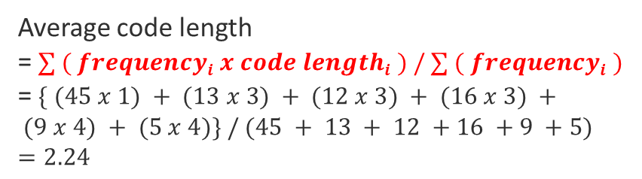
Greedy Algorithm
Problem 3: Huffman Coding
Example 1-
Solution
Question 2: Average code length
.
Characters | Frequencies | Huffman Code
a | 45 | 0
b | 13 | 101
c | 12 | 100
d | 16 | 111
e | 9 | 1101
f | 5 | 1100
0
100
1
45
0
55
1
a
25
30
0
1
0
1
12
13
14
16
c
b
1
d
0
Average code length
= $∑ ( frequencyi x code lengthi ) / ∑ ( frequencyi )$
= $\{ (45 x 1) + (13 x 3) + (12 x 3) + (16 x 3) + (9 x 4) + (5 x 4)\} / (45 + 13 + 12 +16 +9 +5)$
$$=2.24$$
5
9
f
e
Huffman Tree

Slide 91
Greedy Algorithm
Problem 3: Huffman Coding
Example 1-
Solution
Question 3: Length of Huffman encoded message (in bits)
.
Characters | Frequencies | Huffman Code
a | 45 | 0
b | 13 | 101
c | 12 | 100
d | 16 | 111
e | 9 | 1101
f | 5 | 1100
0
100
1
45
0
55
1
a
25
30
0
1
0
1
12
13
14
16
c
b
1
d
0
Total number of bits in Huffman encoded message
= Total number of characters in the message x Average code length per character
= 100 x 2.24
= 224 bits
5
9
f
e
Huffman Tree

Slide 92
Greedy Algorithm
Problem 3: Huffman Coding
Example 3- (Practice yourself)
A file contains the following characters with the frequencies as shown. If Huffman Coding is used for data compression, determine-
Huffman Code for each character
Average code length
Length of Huffman encoded message (in bits)
Characters | a | b | c | d | e | f | g | h
Frequencies | 1 | 1 | 2 | 3 | 5 | 8 | 13 | 21

Slide 93

Thank U

